Slide 1

Search Algorithms
Uninformed Blind search
Breadth-first
uniform first
depth-first
Iterative deepening depth-first
Bidirectional
Informed Heuristic search
– Greedy search, hill climbing, Heuristics
Important concepts:
Completeness
Time complexity
Space complexity
Quality of solution

Slide 2
Uninformed search
Also called blind search.
The term means that the strategies have no additional information about states beyond that provided in the problem definition.
All they can do is generate successors and distinguish a goal state from a non-goal state. All search strategies are distinguished by the order in which nodes are expanded.
Strategies that know whether one non-goal state is “more promising” than another are called informed search or heuristic search strategies

Slide 3
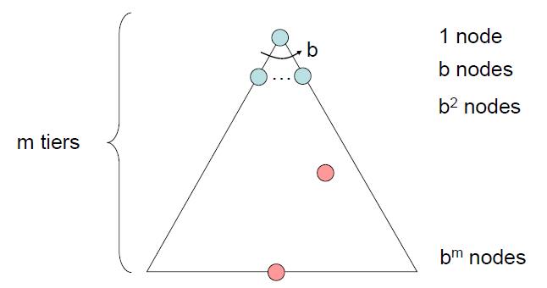

Search Strategies
A search strategy is defined by picking the order of node expansion
Strategies are evaluated along the following four dimensions:
Completeness: does it always find a solution if one exists?
Time complexity: number of nodes generated/expanded during execution
Space complexity: maximum number of nodes or memory required to store the expanded nodes.
Optimality: does it always find a least-cost solution?
Time and space complexity are measured in terms of
b: maximum branching factor of the search tree
d: depth of the least-cost solution
m: maximum depth of the state space (may be ∞)

Slide 4
Breadth-First (Tree) Search
Strategy: expand a shallowest node first
Implementation: Frontier is a FIFO queue
a
G
b
c
d
e
f
S
h
p
q
r
S
d
e
p
Search
Tiers
b
c
e
h
r
q
a
a
h
r
p
q
f
p
q
f
q
c
G
q
c
G
a
a

Slide 5
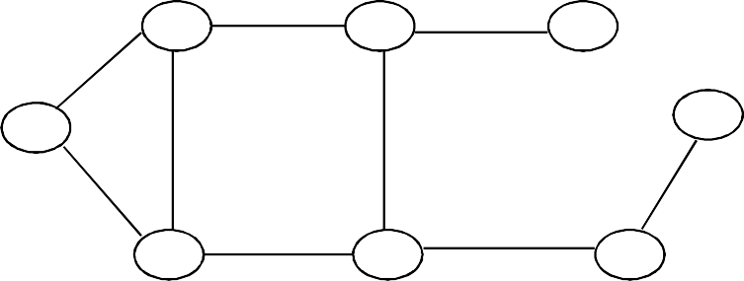
BFS Search Tree
A
B
C
S
G
S
D E F
Queue = {S} Select S Goal(S) = true?
If not, Expand(S)

Slide 6
BFS Search Tree
A
B
C
S
G
S
D E F
A
D
Queue = {A, D} Select A Goal(A) = true?
If not, Expand(A)

Slide 7
BFS Search Tree
A
B
C
S
G
S
D E F
A
D
Queue = {D, B, D} Select D
Goal(D) = true? If not, expand(D)
B
D

Slide 8
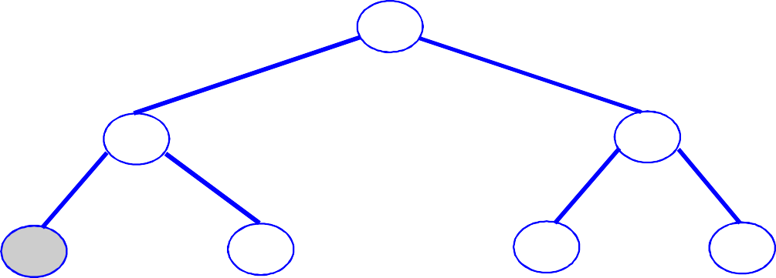
BFS Search Tree
A
B
C
S
G
S
D E F
A
D
Queue = {B, D, A, E}
Select B etc.
B
D
A
E

Slide 9
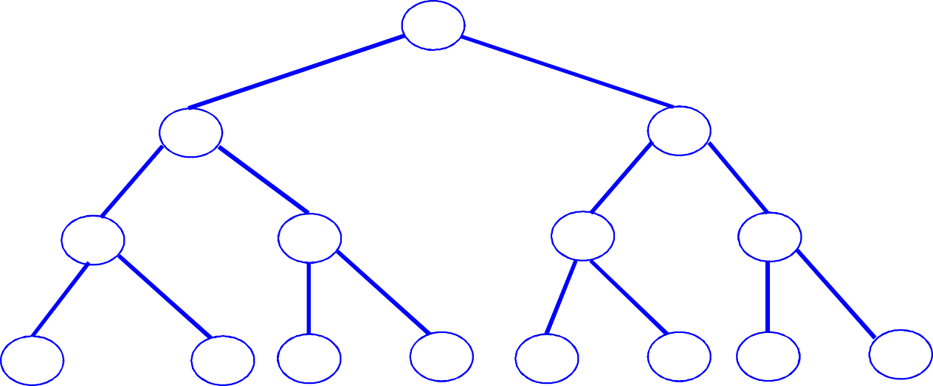
BFS Search Tree
A
B
C
S
G
S
D
E
F
A
D
B
D
A
E
C
E
S
E
S
B
B
F

Slide 10
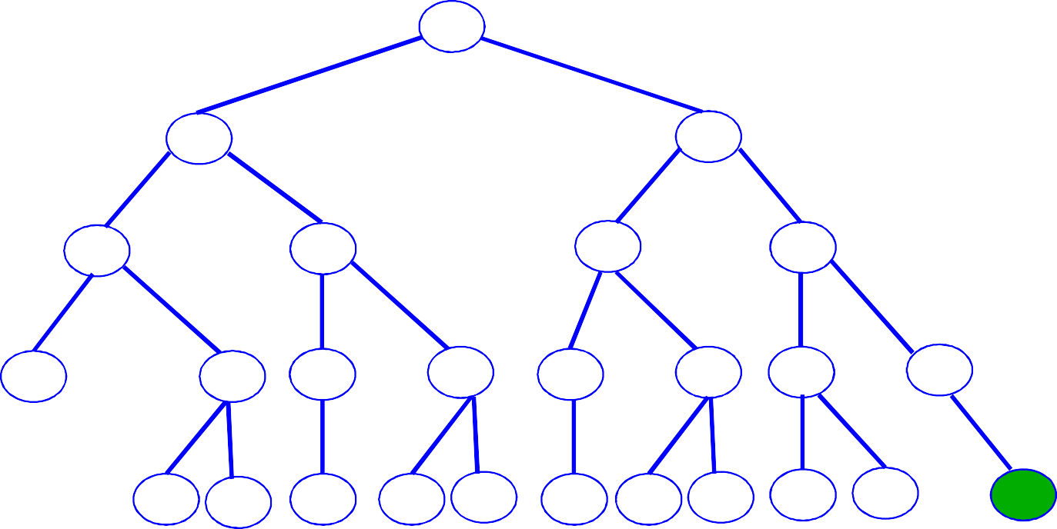
BFS Search Tree
A
B
C
S
G
S
D
E
F
A
D
B
D
A
E
C
E
S
E
S
B
B
F
D F
A B F D C E
A C
G
Level 4
Expand queue until G is at front Select G
Goal(G) = true

Slide 11
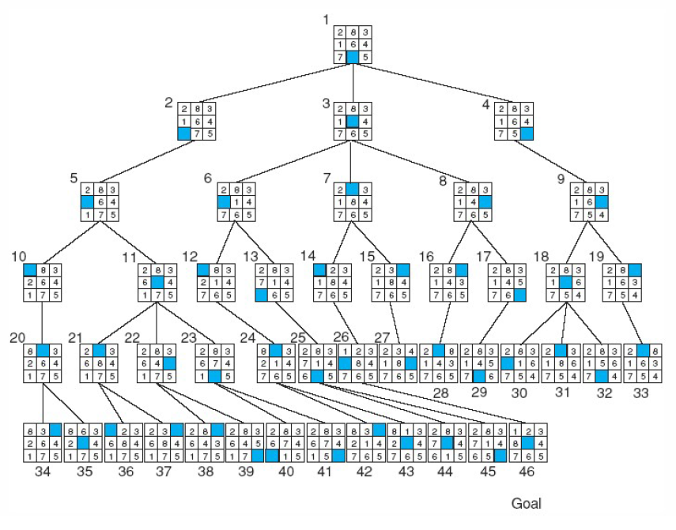
8-Puzzle Problem using BFS

Slide 12
Breadth-First Search (BFS) Properties
What nodes does BFS expand?
Processes all nodes above shallowest solution
Let depth of shallowest solution be s
Search takes time O(b^{s})
How much space does the frontier take?
Has roughly the last tier, so O(b^{s})
Is it complete?
s must be finite if a solution exists, so yes!
Is it optimal?
Only if costs are all the same (more on costs later)
1 node
b
…
b nodes
s tiers
b² nodes
b^{s} nodes
b^{m} nodes

Slide 13
Depth-First (Tree) Search
Strategy: expand a deepest node first
Implementation: Frontier is a LIFO stack
a
G
a
c
b
c
b
e
d
e
d
f
f
S
h
h
p
p
r
q
r
q
S
d
e
p
b
c
e
h
r
q
a
a
h
r
p
q
f
p
q
f
q
c
G
q
c
G
a
a

Slide 14
DFS Search Tree
A
B
C
S
G
S
D
E
F
A
D
Queue = {A,D}

Slide 15
DFS Search Tree
A
B
C
S
G
S
D
E
F
A
D
B
D
Queue = {B,D,D}

Slide 16
DFS Search Tree
A
B
C
S
G
S
D
E
F
A
D
B
D
Queue = {C,E,D,D}
C
E

Slide 17
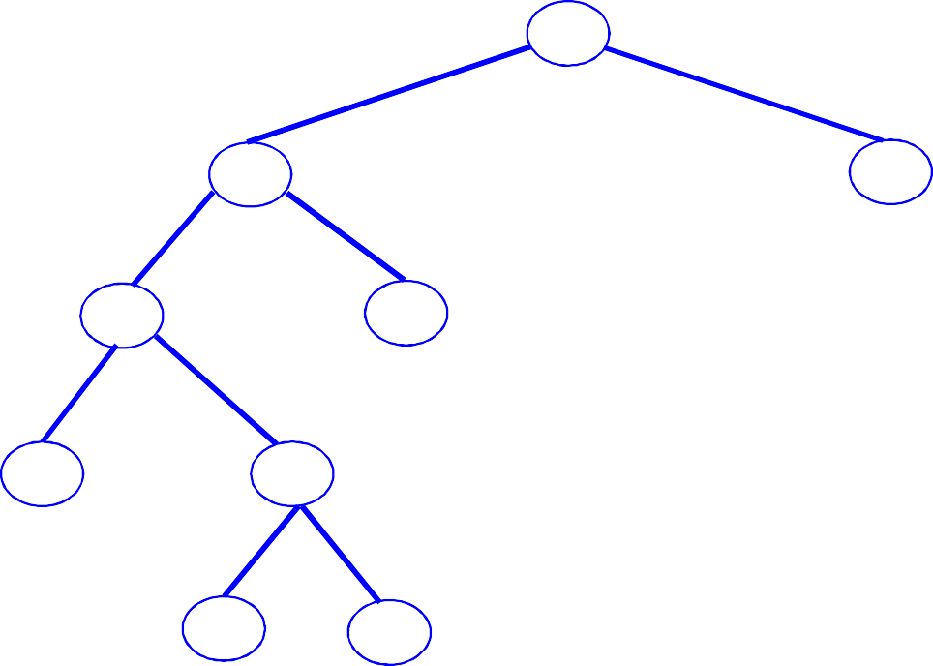
DFS Search Tree
A
B
C
S
G
S
D
E
F
A
D
B
D
Queue = {D,F,D,D}
C
E
D
F

Slide 18
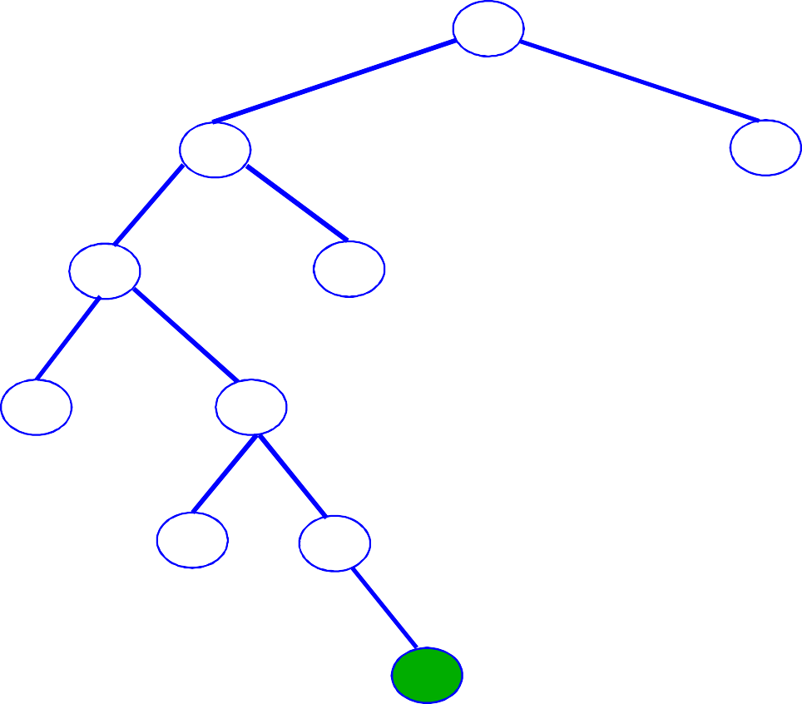
DFS Search Tree
A
B
C
S
G
S
D
E
F
A
D
B
D
Queue = {G,D,D}
C
E
D
F
G

Slide 19
8-Puzzle Problem using DFS

Slide 20
Depth-First Search (DFS) Properties
What nodes does DFS expand?
Some left prefix of the tree.
Could process the whole tree!
If m is finite, takes time O(b^{m})
Space Complexity
Keep Track of current path O(bm)
Is it complete?
Search Tree can be infinite in depth, So DFS can get stuck going deeper forever.
Is it optimal?
No, it finds the “leftmost” solution, regardless of depth or cost ( May Be Wrong path)
1 node
b
…
b nodes
b² nodes
m tiers
b^{m} nodes

Slide 21
Depth-limited search
The failure of depth-first search in infinite state spaces can be alleviated by supplying depth-first search with a predetermined depth limit l.
That is, nodes at depth l are treated as if they have no successors. This approach is called depth-limited search.
Sometimes, depth limits can be based on knowledge of the problem.
For example, on the map of Romania there are 20 cities. Therefore, we know that if there is a solution, it must be of length l = 19 at the longest, so = 19 is a possible choice.

Slide 22
Iterative Deepening Search (IDS)
Run multiple DFS searches with increasing depth-limits.
It does this by gradually increasing the limit—first 0, then 1, then 2, and so on—until a goal is found.
Iterative deepening search
L = 1
While no solution, do
DFS from initial state S₀ with cutoff L If found goal,
stop and return solution,
else, increment depth limit L

Slide 23
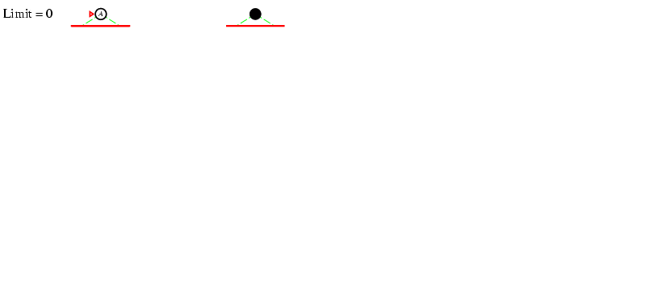
Iterative deepening search L=0

Slide 24
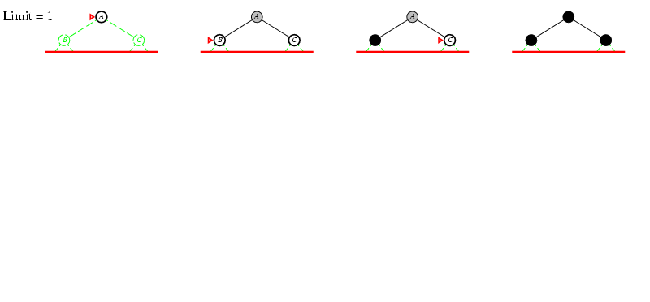
Iterative deepening search L=1

Slide 25
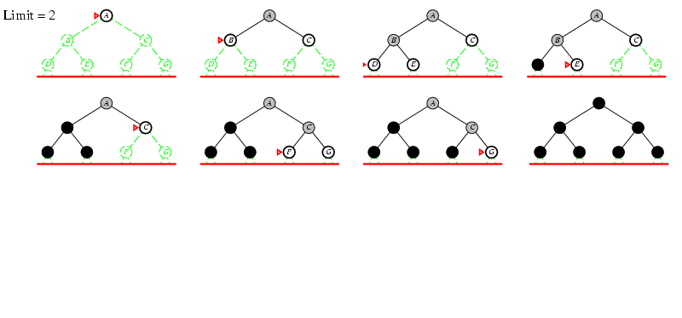
Iterative deepening search L=2

Slide 26
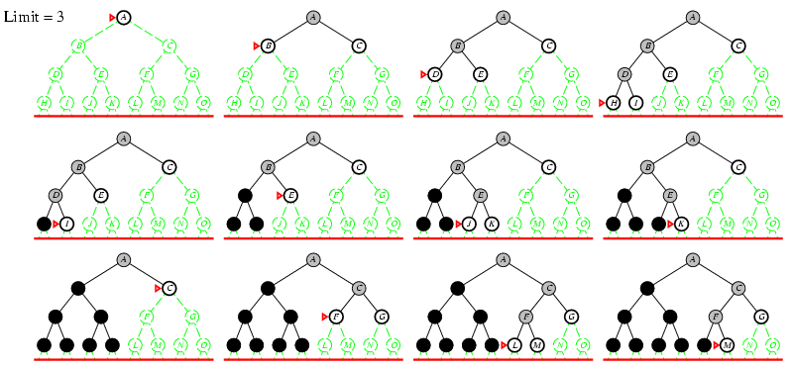
Iterative Deepening Search L=3

Slide 27
Iterative Deepening
Idea: get DFS’s space advantage with BFS’s time / shallow-solution advantages
Run a DFS with depth limit 1. If no solution…
Run a DFS with depth limit 2. If no solution…
Run a DFS with depth limit 3. …..
Isn’t that wastefully redundant?
Generally most work happens in the lowest level searched, so not so bad!
b
…

Slide 28
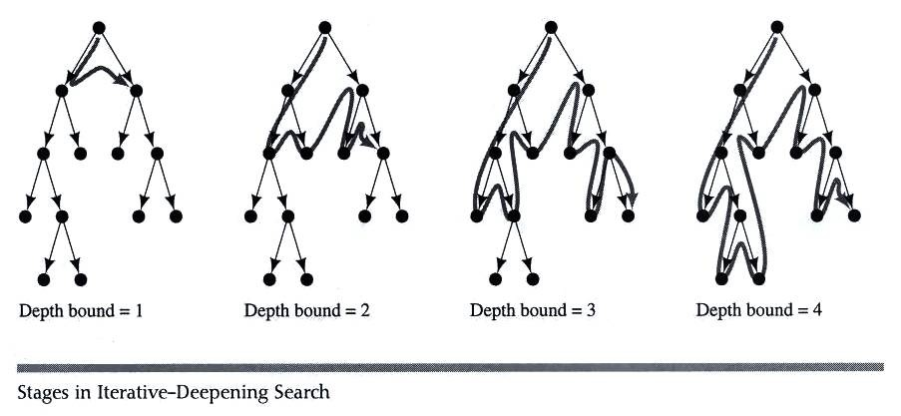
Iterative deepening search

Slide 29
Properties of Iterative Deepening Search
Space complexity = O(bd)
(since its like depth first search run different times, with maximum depth limit d)
Time Complexity = O(b^{d})
Complete?
– Yes
Optimal
– No
IDS combines the small memory footprint of DFS, and has the completeness guarantee of BFS

Slide 30
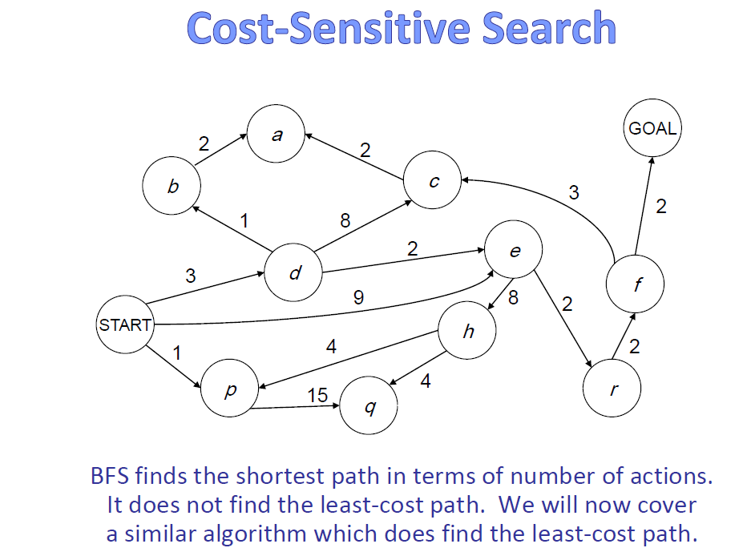

Slide 31
Uniform Cost Search
Optimality: path found = lowest cost
– Algorithms so far are only optimal under restricted circumstances
Let g(n) = cost from start state S to node n
Uniform Cost Search:
Always expand the node on the fringe with minimum cost g(n)
Note that if costs are equal (or almost equal) will behave similarly to BFS

Slide 32
Uniform Cost (Tree) Search
2
G
a
b
1
8
c
Strategy: expand a cheapest node first:
Frontier is a priority queue (priority: cumulative cost)
2
2
3
d
e
f
9
8
2
S
h
1
1
p
q
r
15
0
S
d
3
e
9
p
1
b
4
e
5
h
17
r
11
q
16
c
11
Cost contours
a
6
a
h
13
r
7
p
q
f
p
q
f
8
q
c
G
q
c
a
11
G
10
a

Slide 33
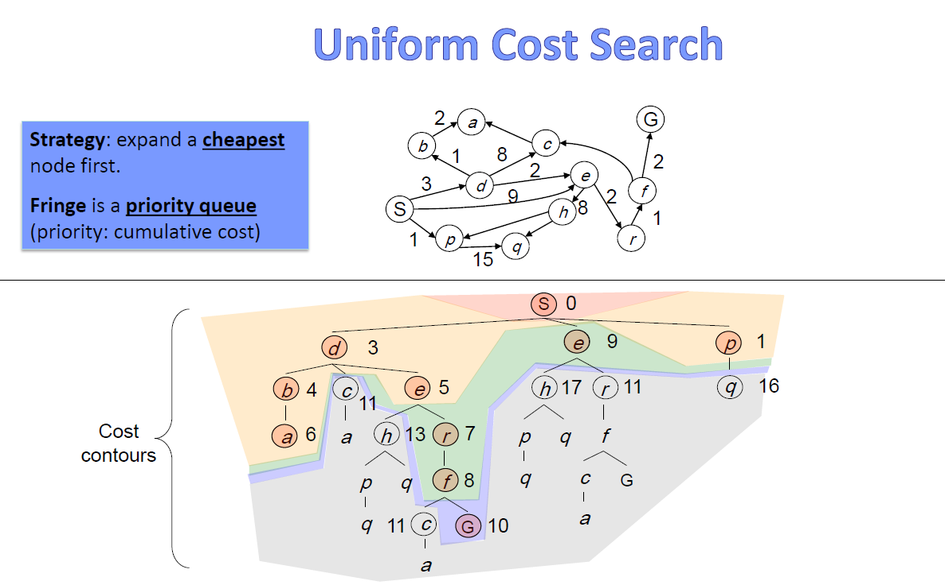

Slide 34
Uniform Cost Search (UCS) Properties
What nodes does UCS expand?
Processes all nodes with cost less than cheapest solution!
If that solution costs C* and arcs cost at least ε , then the “effective depth” is roughly C*/ε
Takes time O(b^{C*/ε}) (exponential in effective depth)
How much space does the frontier take?
Has roughly the last tier, so O(b^{C*/ε})
Is it complete?
Assuming best solution has a finite cost and minimum arc cost is positive, yes!
Is it optimal?
Yes!
b
c ≤ 1
…
C*/ε “tiers”
c ≤ 2
c ≤ 3

Slide 35
